Slide 1

Algorithms and Decision Procedures for Regular Languages
Chapter 9

Slide 2
Decision Procedures
A decision procedure is an algorithm whose result is a Boolean value. It must:
● Halt
● Be correct
Important decision procedures exist for regular languages:
● Given an FSM M and a string s, does M accept s?
● Given a regular expression α and a string w, does α
generate w?

Slide 3
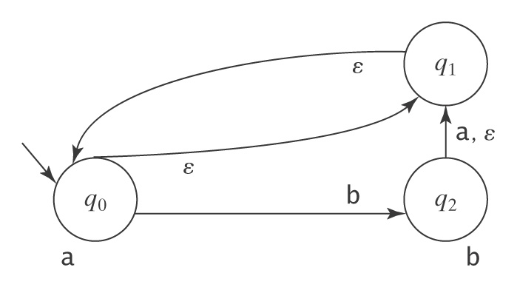
Membership
We can answer the membership question by running an FSM.
But we must be careful:

Slide 4
Membership
decideFSM(M: FSM, w: string) =
If ndfsmsimulate(M, w) accepts then return True
else return False.
decideregex(α: regular expression, w: string) =
From α, use regextofsm to construct an FSM M
such that L(α) = L(M).
Return decideFSM(M, w).

Slide 5
Emptiness, Finiteness, Equivalence
  ● Given an FSM M, is L(M) empty?
  ● Given an FSM M, is L(M) = Σ_{M}*?
  ● Given an FSM M, is L(M) finite?
● Given an FSM M, is L(M) infinite?
● Given two FSMs M₁ and M₂, are they equivalent?

Slide 6
Emptiness
Given an FSM M, is L(M) empty?
The graph analysis approach:
1. Mark all states that are reachable via some path from the
start state of M.
2. If at least one marked state is an accepting state, return False. Else return True.
The simulation approach:
1. Let M′ = ndfsmtodfsm(M).
2. For each string w in Σ* such that |w| < |K_{M}′ | do:
Run decideFSM(M′, w).
3. If M′ accepts at least one such string, return False. Else return True.

Slide 7
Totality
Given an FSM M, is L(M) = Σ_{M}*?
1. Construct M′ to accept ¬L(M).
2. Return emptyFSM(M′ ).

Slide 8
Finiteness
Given an FSM M, is L(M) finite?
The graph analysis approach:

Slide 9
Finiteness
Given an FSM M, is L(M) finite?
The graph analysis approach:
The mere presence of a loop does not guarantee that L(M) is infinite. The loop might be:
  labeled only with ε,
  unreachable from the start state, or
  not on a path to an accepting state.

Slide 10
Finiteness
Given an FSM M, is L(M) finite?
The graph analysis approach:
1. M′ = ndfsmtodfsm(M).
2. M′′ = minDFSM(M′).
3. Mark all states in M′′ that are on a path to an accepting
state.
4. Considering only marked states, determine whether there
are any cycles in M′′.
5. If there are cycles, return False. Else return True.

Slide 11
Finiteness
Given an FSM M, is L(M) finite?
The simulation approach:
1. M′ = ndfsmtodfsm(M).
For each string w in Σ* such that do:
Run decideFSM(M′, w).
If M′ accepts at least one such string, return False.
Else return True.
|K_{M}′ | ≤ |w| ≤ 2⋅|K_{M}′ | - 1

Slide 12
Equivalence
  ● Given two FSMs M₁ and M₂, are they equivalent? In
  other words, is L(M₁) = L(M₂)?
  Two solutions.

Slide 13
Equivalence
  ● Given two FSMs M₁ and M₂, are they equivalent? In
  other words, is L(M₁) = L(M₂)?
equalFSMs₁(M₁: FSM, M₂: FSM) =
1. M₁′ = buildFSMcanonicalform(M₁).
2. M₂′ = buildFSMcanonicalform(M₂).
3. If M₁′ and M₂′ are equal, return True, else return False.

Slide 14
Equivalence
  ● Given two FSMs M₁ and M₂, are they equivalent? In
  other words, is L(M₁) = L(M₂)?
Observe that M₁ and M₂ are equivalent iff:
(L(M₁) - L(M₂)) ∪ (L(M₂) - L(M₁)) = ∅.
equalFSMs₂(M₁: FSM, M₂: FSM) =
1. Construct M_{A} to accept L(M₁) - L(M₂).
2. Construct M_{B} to accept L(M₂) - L(M₁).
3. Construct M_{C} to accept L(M_{A}) ∪ L(M_{B}).
4. Return emptyFSM(M_{C}).

Slide 15
Minimality
  ● Given DFSM M, is M minimal?
1. M′ = minDFSM(M).
2. If |K_{M}| = |K_{M′} | return True; else return False.

Slide 16
Answering Specific Questions
Given two regular expressions α₁ and α₂, is:
(L(α₁) ∩ L(α₂)) – {ε} ≠ ∅?
1. From α₁, construct an FSM M₁ such that L(α₁) = L(M₁).
2. From α₂, construct an FSM M₂ such that L(α₂) = L(M₂).
3. Construct M′ such that L(M′ ) = L(M₁) ∩ L(M₂).
4. Construct M_{ε} such that L(M_{ε}) = {ε}.
5. Construct M′′ such that L(M′′ ) = L(M′ ) - L(M_{ε}).
6. If L(M′′ ) is empty return False; else return True.

Slide 17
Answering Specific Questions
Given two regular expressions α₁ and α₂, are there at least 3 strings that are generated by both of them?

Slide 18
Summary of Closure Properties
● Compute functions of languages defined as FSMs:
● Given FSMs M₁ and M₂, construct a FSM M₃ such that
L(M₃) = L(M₂) ∪ L(M₁).
  ● Given FSMs M₁ and M₂, construct a new FSM M₃ such that
  L(M₃) = L(M₂) L(M₁).
  ● Given FSM M, construct an FSM M* such that
  L(M*) = (L(M))*.
  ● Given a DFSM M, construct an FSM M* such that
  L(M*) = ¬L(M).
  ● Given two FSMs M₁ and M₂, construct an FSM M₃ such that
  L(M₃) = L(M₂) ∩ L(M₁).
  ● Given two FSMs M₁ and M₂, construct an FSM M₃ such that
  L(M₃) = L(M₂) - L(M₁).
  ● Given an FSM M, construct an FSM M* such that
  L(M*) = (L(M))^{R}.

Slide 19
Summary of Decision Procedures
● Decision procedures that answer questions about languages
defined by FSMs:
  ● Given an FSM M and a string s, decide whether s is
  accepted by M.
  ● Given an FSM M, decide whether L(M) is empty.
  ● Given an FSM M, decide whether L(M) is finite.
  ● Given two FSMs, M₁ and M₂, decide whether
  L(M₁) = L(M₂).
  ● Given an FSM M, is M minimal?

